Slide 1
Risk Analysis
James Walden
Northern Kentucky University

Slide 2
Topics
Methodologies and Terminology
Microsoft Threat Modeling (STRIDE)
Data Flow Diagrams (DFDs)
Threat Modeling Tools
Attack Trees
Attack Libraries
Risk Evaluation (DREAD)
Cigital Risk Analysis

Slide 3
Architectural Risk Analysis
Fix design flaws, not implementation bugs.
Risk analysis steps
Develop an architecture model.
Identify threats and possible vulnerabilities.
Develop attack scenarios.
Rank risks based on probability and impact.
Develop mitigation strategy.
Report findings

Slide 4
Risk Analysis Methodologies
Commercial
STRIDE (Spoofing, Tampering, Repudiation, Information disclosure, Denial of service, and Elevation of privilege) from Microsoft
ACSM/SAR (Adaptive Countermeasure Selection Mechanism/Security Adequacy Review) from Sun
Cigital's architectural risk analysis
Standards
ASSET (Automated Security Self-Evaluation Tool) from NIST
OCTAVE (Operationally Critical Threat, Asset, and Vulnerability Evaluation) from SEI
COBIT (Control Objectives for Information and Related Technology) from ISACA

Slide 5
MS Threat Modeling Process
Step 1: Model
Step 2: Enumerate Threats
Step 3: Mitigate
Step 4: Validate
OWASP
Notes:
Image from http://www.owasp.org/index.php/Threat_Risk_Modeling

Slide 6
Step 1: Diagramming
Step Objective: To model an application design as a data flow diagram to drive threat analysis
Data flow diagrams (DFDs)
Widely used and easily understood graphical representation
Most attacks based on data flowing through an application or system
Trust boundaries

Slide 7
Data Flow Diagram Elements
Element | Represented By | Description
External Entity |  | Any entity not within the control of the application, such as people and external systems
Process |  | Code, such as native code executables and .NET assemblies
Data Store |  | Data at rest, such as registry keys and databases
Data Flow |  | How data flows between elements, such as function calls and network data

Slide 8
Trust Boundaries
Element | Represented By | Description
Trust Boundary |  | A point within an application where data flows from one privilege level to another, such as network sockets, external entities and processes with different trust levels

Slide 9
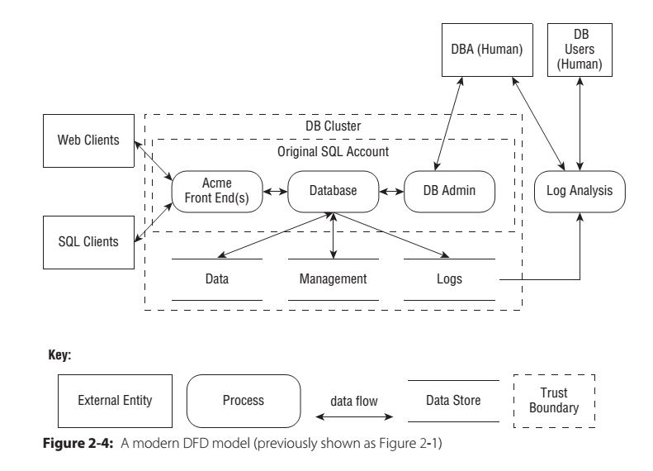
DFD for a DB-driven Application
Threat Modeling: Designing for Security, Figure 2.4

Slide 10
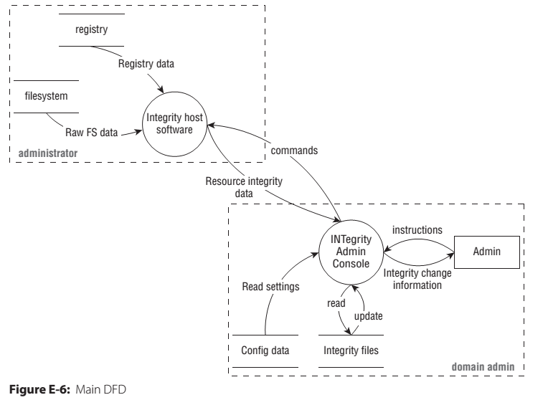
DFD for File Integrity Checker
Threat Modeling: Designing for Security, Figure E-6

Slide 11
Step 2: Threat Enumeration
Step Objective: To identify threats for each data flow diagram element in the threat model.
Experts: Brainstorming and other informal methods
Experts and Non-Experts: STRIDE threat types
Based on Microsoft Security Response Center (MSRC) issues and Common Vulnerability and Exposures (CVE) (see http://cve.mitre.org for more information)

Slide 12
STRIDE Threat Types
Desired Property | Threat | Definition
Authentication | Spoofing | Impersonating something or someone else.
Integrity | Tampering | Modifying code or data without authorization
Non-repudiation | Repudiation | The ability to claim to have not performed some action against an application
Confidentiality | Information Disclosure | The exposure of information to unauthorized users.
Availability | Denial of Service | The ability to deny or degrade a service to legitimate users.
Authorization | Elevation of Privilege | Ability of user to elevate privileges without authorization.

Slide 13
STRIDE by DFD Element Type
Element | S | T | R | I | D | E
External entity |  |  | 
Process |  |  |  |  |  | 
Data Store |  |  |  |  | 
Data Flow |  |  |  |  | 

Slide 14
Spoofing
Threat | Attacker Action | Examples
Spoofing a process | Renaming | Change process name to “sshd” to look innocuous.
Spoofing a file | Create file with expected name. | Create Trojan Horse “ls” in a directory.
 | Create many files in expected directory. | Create 1000s of files in /tmp named pid.NNNN to match name used.
Spoofing a machine | MAC spoofing | Clone another device’s MAC to use wireless.
 | IP spoofing | Make DoS attack appear to come from other PC.
Spoofing a person | E-mail address spoofing. | Send e-mails that appear to come from target.
 | Take over real account. | Send twitter spam.

Slide 15
Tampering
Threat | Attacker Action | Examples
Tampering with a file | Modify a file owned by attacker that you rely on. | Change Javascript file included by many sites.
 | Modify a file owned by you. | Uses malware to modify your hosts file to redirect browser.
Tampering with memory | Inserts code in memory. | Uses buffer overflow to inject malicious code.
 | Modifies data in memory. | Changes access level to permit attacker access.
Tampering with networks | Redirect flow of data to their machine. | Stage 1 of a MITM attack.
 | Modify data flowing over network. | Insert malware into legitimate web page viewed by victim.

Slide 16
Repudiation
Threat | Attacker Action | Examples
Repudiating an Action | Claims to not have clicked. | Attacker claims not have purchased.
 | Claims to have not received. | Attacker claims payment or item not delivered.
 | Claims to be fraud victim.
 | Uses another person’s account to do action.
 | Uses another person’s credit card.
Attacking the logs | Deletes transaction logs.
 | Injects fake transactions into transaction logs.

Slide 17
Information Disclosure
Threat | Attacker Action | Examples
Disclosure from process | Extracts secrets from error messages. | Attacker learns SQL table and column names from DB error.
 | Extracts secrets from memory. | Uses format string attack to read stack memory.
Disclosure from disk | Takes advantage of incorrect ACLs. | Reads files with confidential data.
 | Finds files protected only by obscurity. | Guesses admin interface URL for web app.
 | Finds cryptographic keys on disk.
Disclosure on network | Sniffs network data. | Obtains cleartext telnet or ftp passwords.
 | Learns who’s talking to whom by watching DNS. | Sometimes metadata is as important as data.

Slide 18
Denial of Service
Threat | Attacker Action | Examples
DoS process | Use all memory. | malloc(ALL_RAM)
 | Use all CPU. | while(1) fork();
DoS data store | Fill disk. | dd if=/dev/zero of=/target
 | Make many requests to database or SAN. | Prevents DB from servicing legitimate requests.
DoS data flow | Send many packets from many hosts (DDoS).
 | Make many requests to server.
 | Use RST sniping to terminate TCP connections.

Slide 19
Elevation of Privilege
Threat | Attacker Action | Examples
Elevate process privilege | Prevent privileged process from dropping privilege.
 | Use malformed data to make process perform unauthorized actions. | Attacker uses buffer overflow exploit to inject malicious code.
 | Exploit incorrect ACLs to access admin interface.
Exploit data flow | Use malformed data to inject code into data flow send to third component. | SQL injection.
Cross-domain attacks | Reflect user input into a different context. | Reflected cross-site scripting attacks.
Exploit data store | Modify user permission bits in data store. | Insert new root account into /etc/passwd file.

Slide 20
Step 3: Mitigation
Step Objective: To address identified threats to an application design.
Approaches to threat mitigation (in order of preference):
Redesign
Use standard mitigations
Use unique mitigations
Accept risk in accordance with policies

Slide 21
Examples of Mitigations
Threat | Mitigation
Spoofing | IPsec Digital signatures Message authentication codes Hashes
Tampering | ACLs Digital signatures Message Authentication Codes
Repudiation | Strong Authentication Secure logging and auditing
Information Disclosure | Encryption ACLs
Denial of Service | ACLs Quotas High availability designs
Elevation of Privilege | ACLs Group or role membership Input validation

Slide 22
Step 4: Validation
Step Objective: To help ensure that threat models accurately reflect application design and potential threats
Validation of the model
Validation of enumerated threats
Validation of mitigations
Validation of assumptions

Slide 23
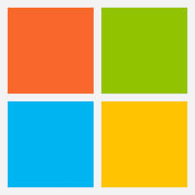



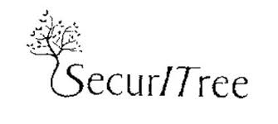

Threat Modeling Tools
Microsoft Threat Modeling Tool 2014
OctoTrike
Sea Sponge

Slide 24
Attack Trees
Decompose threats into individual, testable conditions using attack trees.
Attack Trees
Hierarchical decomposition of a threat.
Root of tree is adversary’s goal in the attack.
Each level below root decomposes the attack into finer approaches.
Child nodes are ORed together by default.
Special notes may indicate to AND them.

Slide 25
Attack Trees—Graph Notation
Goal: Read file from password-protected PC.
Read File
Get Password
Network Access
Physical Access
Search Desk
Social Engineer
Boot with CD
Remove hard disk
Notes:
Graph represents decision-making process of attacker.
Root node represents goal; leaves represent methods of achieving goals.
Leaves become more specific lower in tree.
Most child nodes represent logical ORs, but some represent ANDs (get encrypted key file AND password used to encrypt it.)
Assign values to nodes, representing perceived risk, i.e. how feasible is the attack.

Slide 26
Attack Trees—Text Notation
Goal: Read message sent from one PC to another.
1. Convince sender to reveal message.
1.1 Blackmail.
1.2 Bribe.
2. Read message when entered on sender’s PC.
1.1 Visually monitor PC screen.
1.2 Monitor EM radiation from screen.
3. Read message when stored on receiver’s PC.
1.1 Get physical access to hard drive.
1.2 Infect user with spyware.
4. Read message in transit.
1.1 Sniff network.
1.2 Usurp control of mail server.

Slide 27
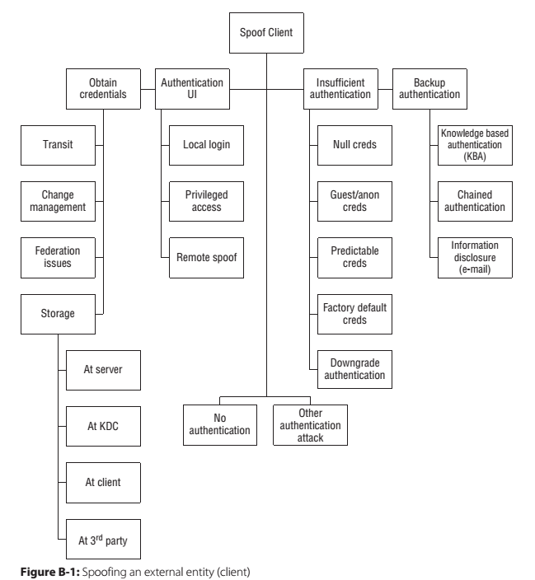
Example Tree: Spoofing Client
Threat Modeling: Designing for Security

Slide 28
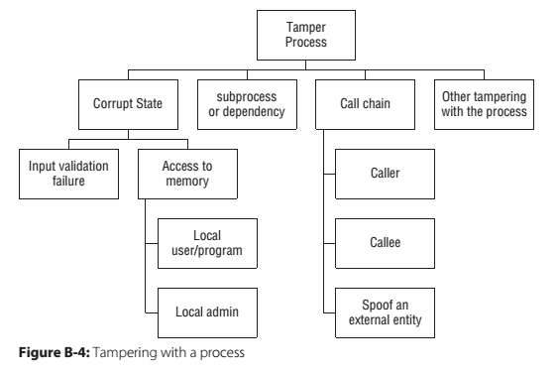
Example Tree: Tamper Process
Threat Modeling: Designing for Security

Slide 29
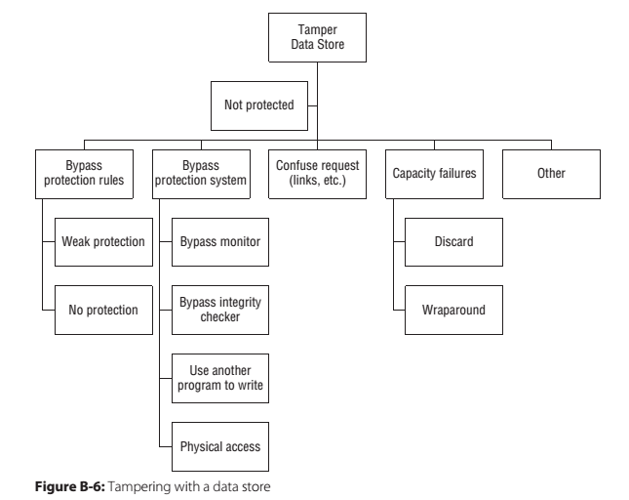
Example: Tamper Data Store
Threat Modeling: Designing for Security

Slide 30
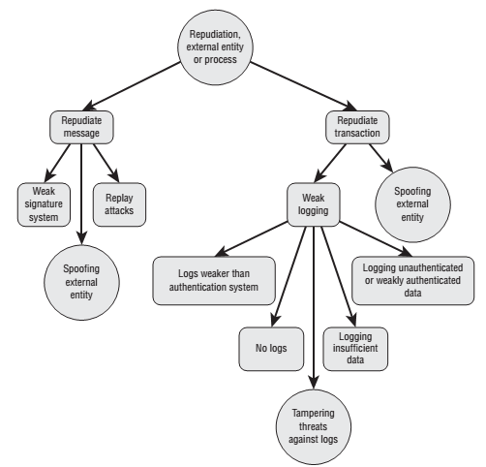
Example Tree: Repudiation
Threat Modeling: Designing for Security, Figure 4.3

Slide 31
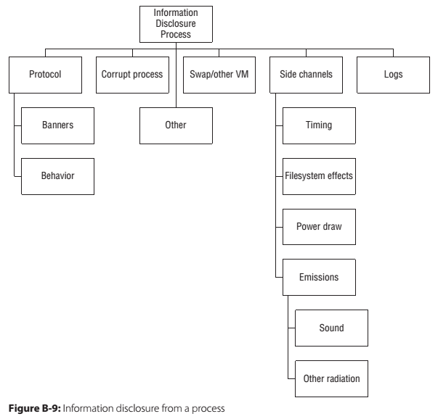
Example: Information Disclosure
Threat Modeling: Designing for Security

Slide 32
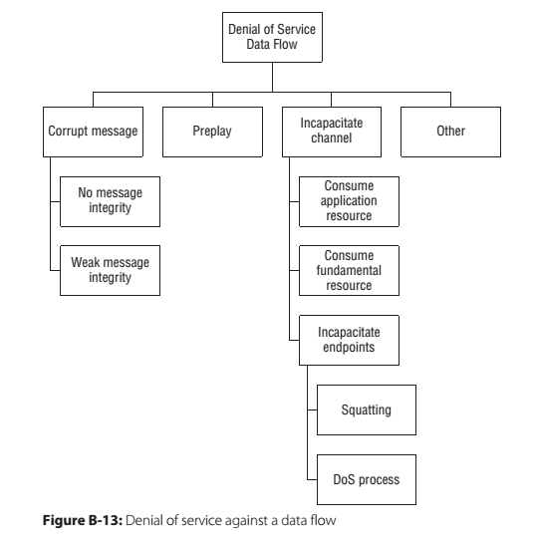
Example: Denial of Service
Threat Modeling: Designing for Security

Slide 33
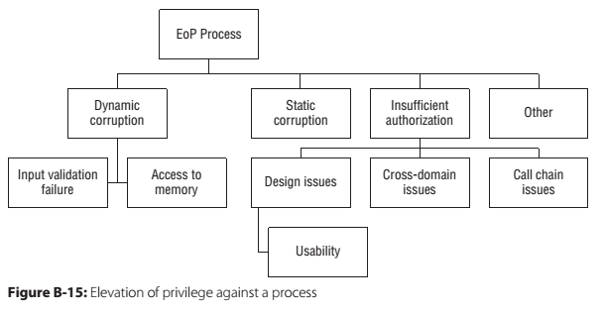
Example: Elevation of Privilege
Threat Modeling: Designing for Security

Slide 34
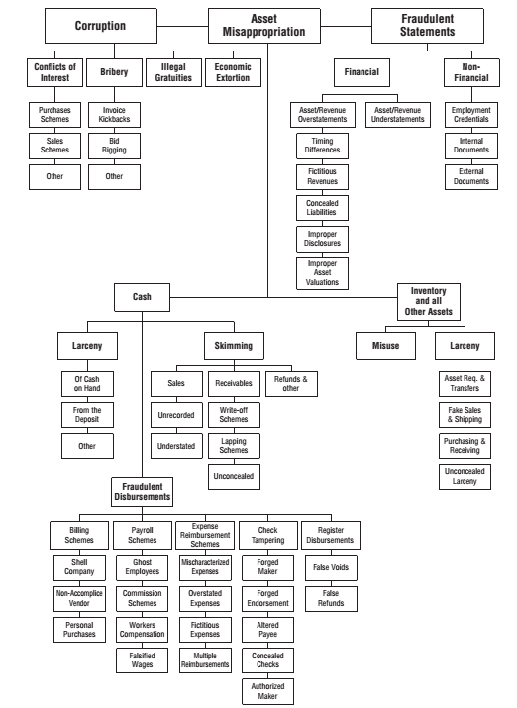
Example Tree: ACFE Fraud
Threat Modeling: Designing for Security, Figure 4.4

Slide 35
CAPEC
Common Attack Pattern Enumeration and Classification
Structured library of attacks.
Found at https://capec.mitre.org/.
Examples
HTTP Response Splitting (CAPEC-34)
Session Fixation (CAPEC-61)
Cross Site Request Forgery (CAPEC-62)
SQL Injection (CAPEC-66)
Simple Script Injection (CAPEC-63)
Buffer Overflow (CAPEC-100)
Clickjacking (CAPEC-103)
Relative Path Traversal (CAPEC-139)
XML Attribute Blowup (CAPEC-229)

Slide 36
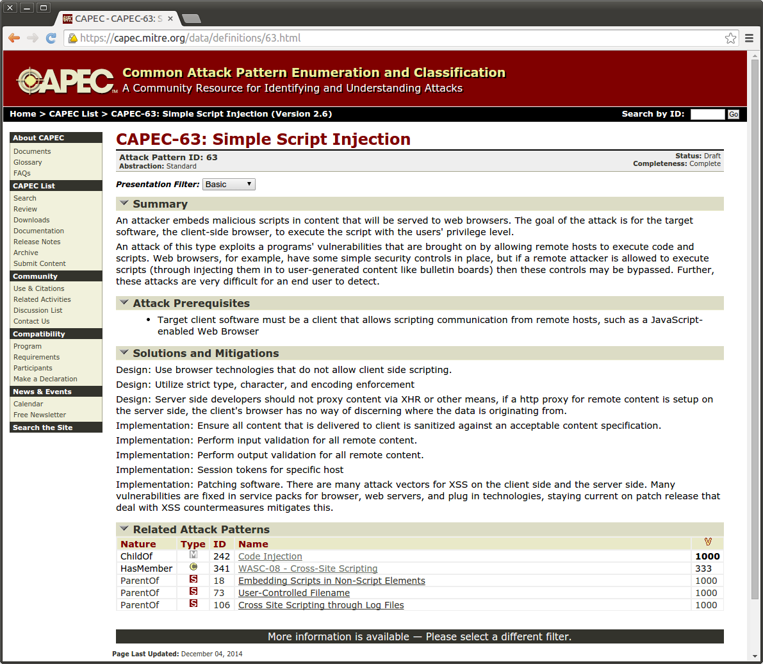
CAPEC Example Attack

Slide 37
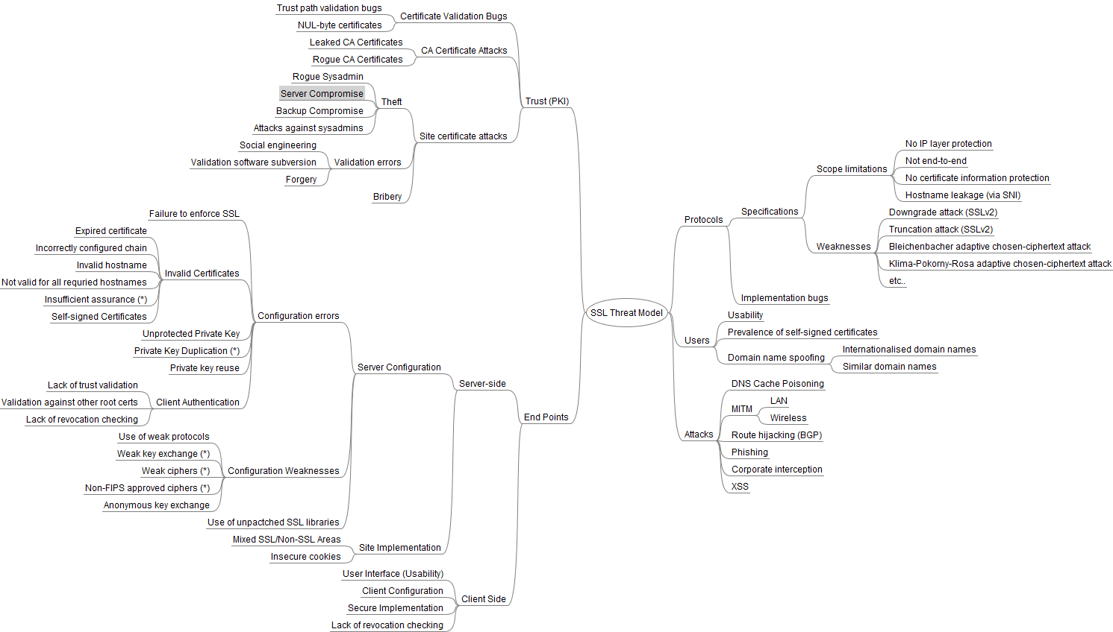
Threat Model as Mind Map
Notes:
http://blog.ivanristic.com/2009/09/ssl-threat-model.html

Slide 38
Quantifying Threats
Calculate risk value for nodes in attack tree
Start at bottom of tree.
Assign value to each node.
Propagate risk values to parent nodes.
Sum risk values if child nodes are ANDed together.
Use highest risk value of all children if nodes are ORed together.
Alternate technique: monetary evaluation
Estimate monetary value to carry out attacks.
Propagate values to parent nodes as above.
Note: smaller values are higher risks in this method.

Slide 39
DREAD = (D + R + E + A + D)/5
Damage Potential
Extent of damage if vulnerability exploited.
0 = Nothing
5 = Individual user data compromised
10 = Complete system or data destruction
Reproducibility
How often attempt at exploitation works.
0 = Very hard or impossible, even for admins.
5 = One or two steps required, may need authorized user.
10 = Just a web browser required, not auth needed.
Exploitability
Amount of effort required to exploit vulnerability.
0 = Advanced programming and network knowledge required.
5 = Malware exists on Internet or exploit with known tools.
10 = Just a web browser.

Slide 40
DREAD = (D + R + E + A + D)/5
Affected Users.
Ratio of installed instances of system that would be affected if exploit became widely available.
0 = None.
5 = Some users, but not all.
10 = All users.
Discoverability
Likelihood that vulnerability will be discovered.
0 = Very hard, requires source code or admin access.
5 = Can figure out by guessing or sniffing network.
9 = Details of faults like this already in public domain.
10 = Information visible in web browser.

Slide 41
Annualized Loss Expectancy
ALE = SLO * ARO
SLO = Single Loss Occurrence
ARO = Annualized Rate of Occurrence
Example
SLO = $200 for a single account's data breach
ARO = 10,000 per year
ALE = $2,000,000
Qualitative risk assessment
SLO = High(100), medium(50), low(10).
ARO = High(1.0), medium(0.5), low(0.1).

Slide 42
Justifying Security Spending
Risk Analysis
If we spend $X, it will reduce loss of $Y by Z%.
Due Diligence
We must spend $X on Y because it’s industry standard.
Incident Response
We must spend $X on Y so Z never happens again.
Regulatory Compliance
We must spend $X on Y because PCI says so.
Competitive Advantage
We must spend $X on Y to make customer happy.
Notes:
http://jeremiahgrossman.blogspot.com/2008/12/budgeting-for-web-application-security.html

Slide 43
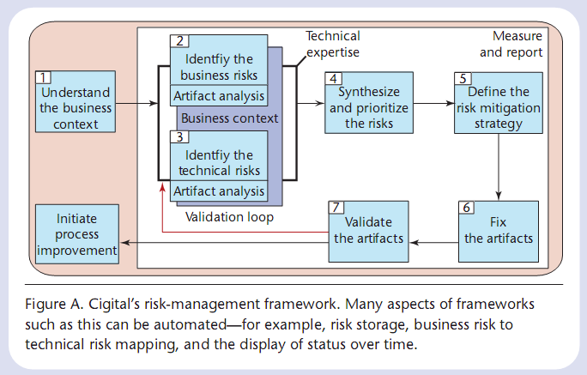
Cigital
Understand business context.
Identify business risks.
Identify technical risks.
Prioritize risks.
Define risk mitigation strategy.
Notes:
Image from bsi3-risk.pdf

Slide 44
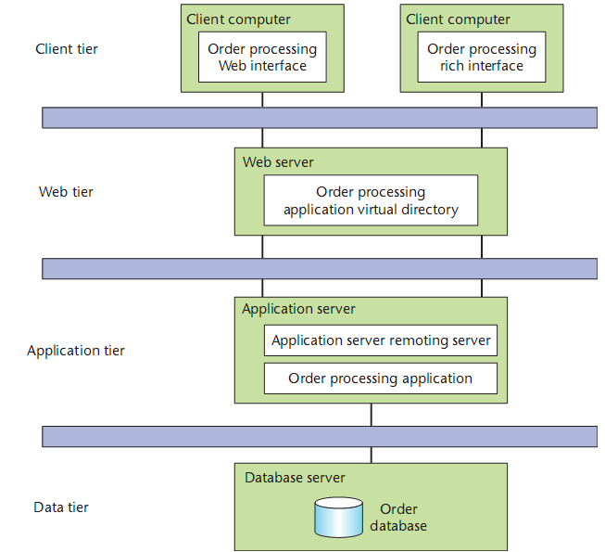
Risk Analysis Phases
Develop architectural overview.
Attack resistance analysis.
Ambiguity analysis.
Weakness analysis.

Slide 45
Attack Resistance Analysis
Find known problems with system.
Use STRIDE-type categorization.
Use checklists and attack patterns.
Types of flaws found.
Authentication tokens can be guessed/misused.
Misuse of cryptographic primitives.
Absence of a single point of entry.

Slide 46
Ambiguity Analysis
Discover new risks in the software.
Architects develop own understanding of system.
Identify conflicts between different architects.
Types of flaws found.
Protocol, authentication problems.
Password retrieval, fitness, and strength.

Slide 47
Weakness Analysis
Impact of external software dependencies.
Frameworks and shared libraries.
Network topology.
Platform.
Build environment.
Physical environment.
Types of flaws found.
Browser and VM sandboxing failures.
Insecure service provision—RMI, COM, etc.
Debug interfaces.
Interposition attacks—libraries, client spoofing.

Slide 48
Key Points
Risk Analysis Steps
Develop an architecture model (DFD).
Identify threats and possible vulnerabilities.
Develop attack scenarios.
Rank risks based on probability and impact.
Develop mitigation strategy.
Report findings
DFD diagram construction
Attack tree construction
STRIDE risk categorization
DREAD risk evaluation

Slide 49
References
CLASP, OWASP CLASP Project, http://www.owasp.org/index.php/Category:OWASP_CLASP_Project, 2008.
Karen Goertzel, Theodore Winograd, et al. for Department of Homeland Security and Department of Defense Data and Analysis Center for Software. Enhancing the Development Life Cycle to Produce Secure Software: A Reference Guidebook on Software Assurance, October 2008.
Jeremiah Grossman, “Budgeting for Web Application Security,” http://jeremiahgrossman.blogspot.com/2008/12/budgeting-for-web-application-security.html, 2008.
Michael Howard and Steve Lipner, The Security Development Lifecycle, Microsoft Press, 2006.
Gary McGraw, Software Security, Addison-Wesley, 2006.
Microsoft, Threat Modeling Tool 2014 SDK, 2014.
NIST, Risk Management Guide for Information Technology Systems, NIST SP 800-30, 2002.
OWASP, Threat Risk Modeling. http://www.owasp.org/index.php/Threat_Risk_Modeling, 2009.
Ivan Ristic, SSL Threat Model, http://blog.ivanristic.com/2009/09/ssl-threat-model.html, 2009.
Paul Saitta, Brenda Larcom, and Michael Eddington, “Trike v.1 Methodology Document [draft],” http://dymaxion.org/trike/, 2005.
Adam Shostack, Threat Modeling: Designing for Security, Wiley, 2014.

